Slide 1
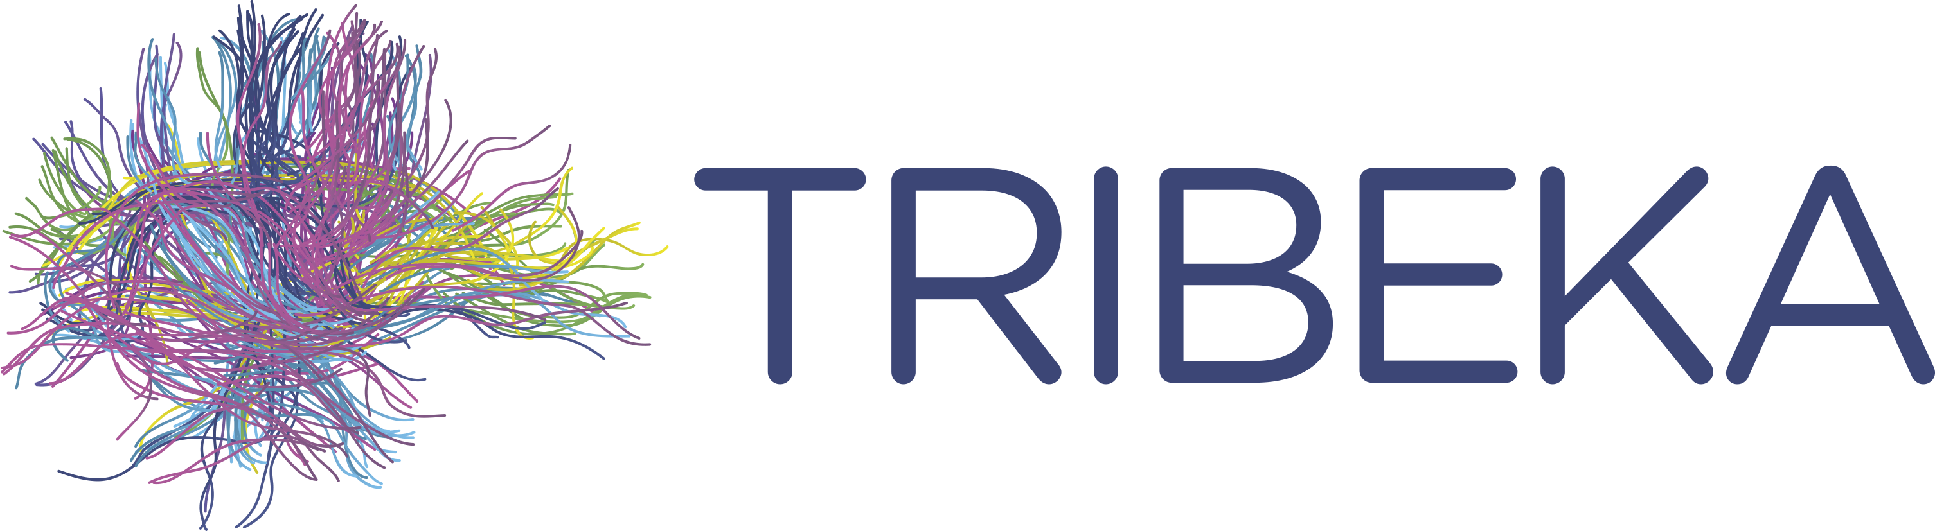



José L Molinuevo, Craig Ritchie, Miia Kivipelto
tribeka.org
@TRIBEKAplatform

Slide 2
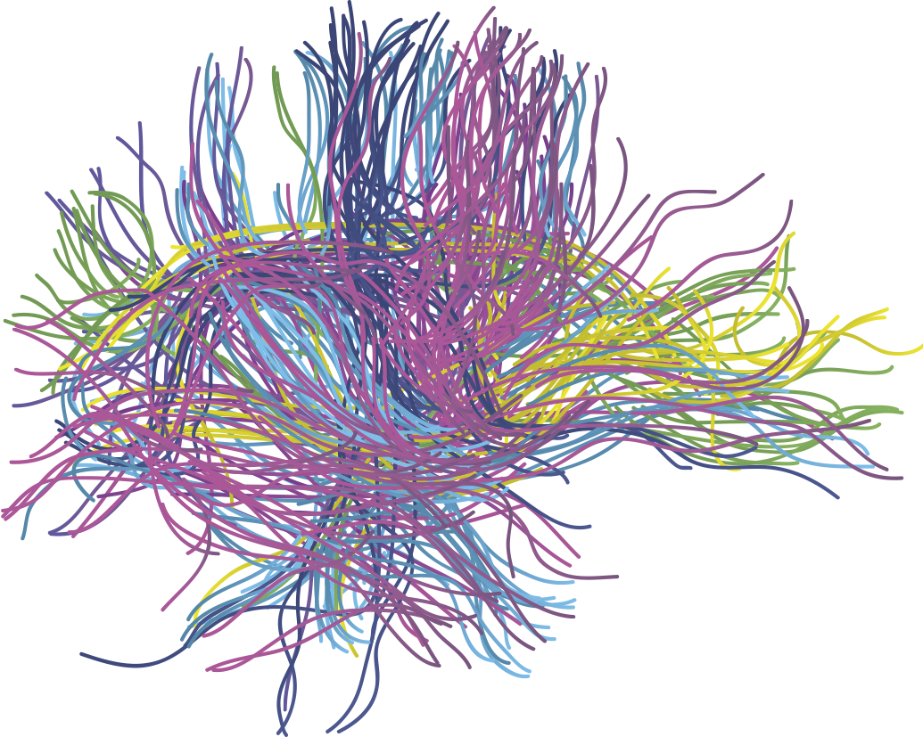
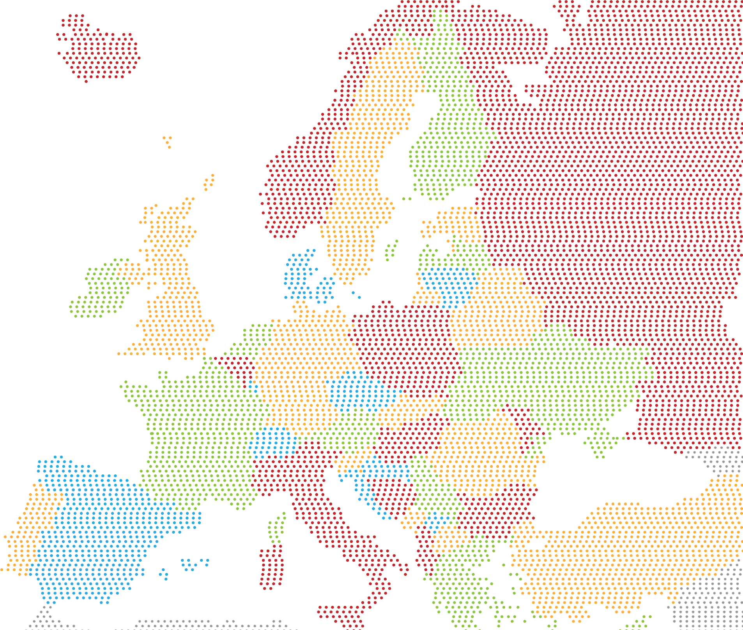


The TriBEKa imaging consortium
Barcelona-Edinburgh-Karolinska
The mission of the consortium is to generate an open access neuroimaging platform for understanding early preclinical changes, even pre-amyloid deposition, in the AD continuum and other neurodegenerative conditions
FINGER

Slide 3

The TriBEKa imaging consortium
Barcelona-Edinburgh-Karolinska
The project has received a £1.9m investment from the Alzheimer’s Association and an anonymous international charitable foundation

Slide 4
«Since a cure for dementia is not yet available, ﬁnding effective preventive strategies is essential for a sustainable society in an aging world»
Medical attention
Differential diagnosis
Clinical Research
Normal
AD Preclinical Stage
Mild Cognitive Impairment due to AD
Dementia due to AD
Normal pathology
No symptoms
Incipient AD pathology
No symptoms
Moderate pathology
Memory disorders
Intense pathology
Dementia
Pathological continuum
Mangialasche et al. Alzheimers Res Ther 2012; 4 (1): 6
Cummings J, Dubois B, Molinuevo JL, Scheltens P. IWG criteria for the diagnosis of Alzheimer disease Med Clin North Am;97:363-8.

Slide 5

TriBEKa: Barcelona-Edinburgh-Karolinska
September 21, 2015- 8 PM in Stockholm, Miia Kivipelto (Finger Study PI), Craig Ritchie (Prevent Study PI) and José Luis Molinuevo (ALFA study PI) joined forces in the fight to prevent AD
We need to create new infrastructures to accommodate this paradigm shift (structural and research ones)
The three studies are focused in prevention
ALFA and PREVENT targeting a younger population
TriBEKa imaging platform was decided as a first outcome of this collaboration

Slide 6

TriBEKa aims
To deliver characterized data for understanding neurodegenerative disease and related clinical models in midlife
Becoming a key source of information through an Open Access platform
Modelling and understanding early pathophysiological changes, pre amyloid deposition, in the AD continuum
Disentangle the role of the different risk factors
Informative for designing prevention trials

Slide 7
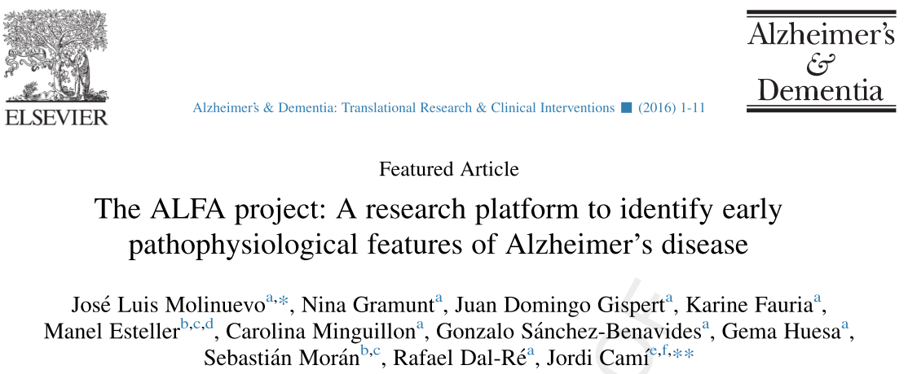

PET tau
ALFA life (400)
ALFA COGNITION
EPAD (300)
AMYPAD (120)
PET (400)
ALFA+ (450)
ALFA GWAS/MRI/ECO (2.000)
ALFA 1800
…
…
COGNITION AND GENETICS
Subgroup MRI (600)
PARENT COHORT ALFA (2.743)
ALFA Registry (n=6.500)

Slide 8
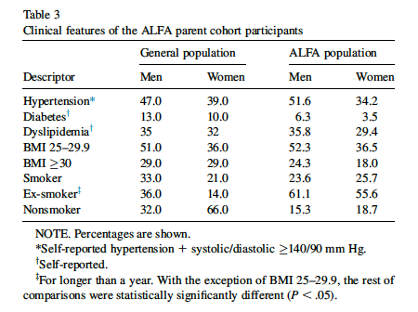
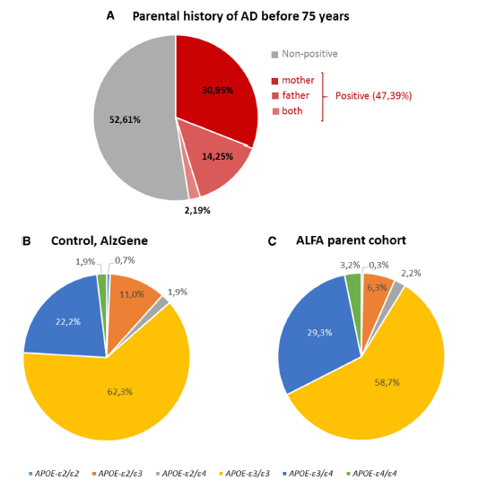
ALFA population description

Slide 9
ALFA population description
It will include 450 cognitively normal participants, between 45 and 65 years old, enriched for AD risk factors

Slide 10
IMAGING BIOMARKERS
MRI
Structural MRI: 3D high resolution T1, clinical sequences (T2 and FLAIR), Diffusion Weighted Imaging, ASL and T1 rho (novel MRI sequences for protein load).
Functional MRI (resting state and memory tasks),
Brain metabolism by ¹H MR spectroscopy and
PET imaging
Amyloid imaging
185 MBq of ¹⁸F-Flutemetamol in 10 ml containing a maximum product mass of 6mg/ml.
GE healthcare support
FDG
Tau imaging n=200
WET BIOMARKERS
CSF biomarkers
Aβ42, ttau, ptau (Roche diagnostics)
YKL40
Neurogranin
Aβ oligomers
Blood biomarkers
Exploratory markers to be decided

Slide 11
Key Points
Five centers in UK and Ireland
N=700 baseline assessments completed by Summer 2018.
Age range 40-59
1:1 balance of family history +/-

Slide 12
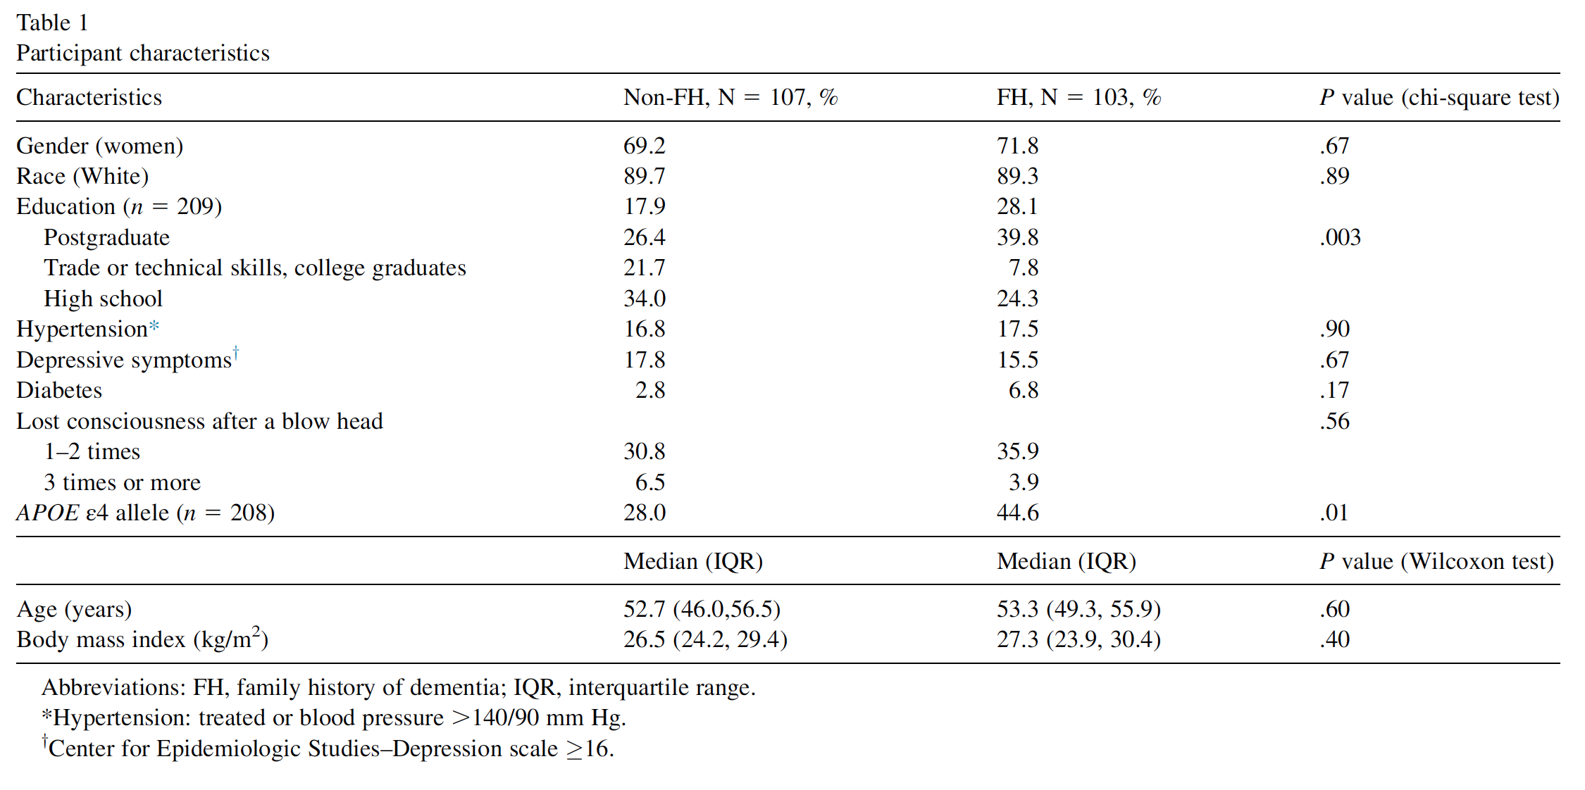
Pilot Population Characteristics

Slide 13
Risk Factor Assessment
Domain | Risk | Measurement
Principal Risk Model | ApoE Genotype
 | Family History
Genetic | ApoE and GWAS*
Environmental | Diet | Scottish Food Frequency Questionnaire
 | Life-events | Life Stressor Checklist
 | Sleep | Pittsburgh Sleep Evaluation
 | Exercise | Study Proforma
Clinical | Head Injury | Brain Injury Screening Questionnaire
 | Inflammation | Biomarkers
 | Cardiovascular/Metabolic Syndrome | Biomarkers*/ECG/History and Examination
 | Depression | CED-D
 | Respiratory | Spirometry/History and Examination
 | Stress | Salivary Cortisol/Resilience Questionnaire
 | Endocrine | Haematology/Biochemistry and History & Examination
* Subject to additional funding

Slide 14
Expressions of disease state
Imaging
fMRI with task, Magnetic Resonance Spectroscopy, Diffusion Tensor Imaging, vMRI, WML volume
Amyloid PET imaging via Alliance (n=300)
Cerebrospinal Fluid (40%)
Blood (Whole blood and plasma)
Saliva
Urine
Cognition: COGNITO, Four Mountain Test, Supermarket Trolley, Verbal Short Term Memory Binding Paradigm

Slide 15
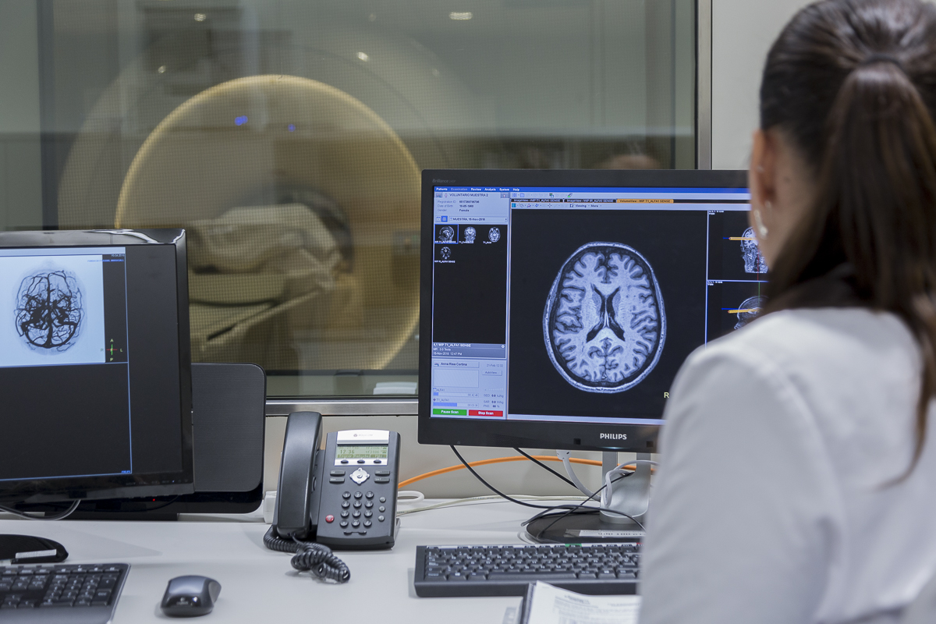
TriBEKa: Current status

Slide 16
Alfa+ Recruitment Progress and Academic Output
2016
2017
2018
2019
First participant
recruited
150 participants
Last baseline
Participant in
n=450
Interim analysis
N=200
Baseline
Analysis
FU visits

Slide 17
PREVENT Dementia Recruitment Progress and Academic Output
2014
2015
2017
2018
First Subject Recruited
Last baseline n=700 subject recruited
Analysing n=210 baseline pilot data
Analysing n=210 2-year FU pilot data

Slide 18
TriBEKa imaging platform
The TriBEKa platform is an example of early preclinical AD focused collaborative initiatives
Mission: to generate an open access neuroimaging platform for understanding early preclinical changes in the AD continuum and other neurodegenerative conditions
Aims:
To deliver characterized data for understanding neurodegenerative disease and related clinical models in midlife
Becoming a key source of information through an Open Access platform
Modelling and understanding early pathophysiological changes, pre amyloid deposition, in the AD continuum
Disentangle the role of the different risk factors
Informative for designing prevention trials

Slide 19
Thank you!
tribeka.org
@TRIBEKAplatform

